Slide 1
Purchase AudioCodes Handsets
Log into SIMBA
Click on the Shop Onlion tile
Next click the Shop link
Then click the Lion Marketplace link
Click the CDWG Tile
On the left side, click AudioCodes Phones

Slide 2
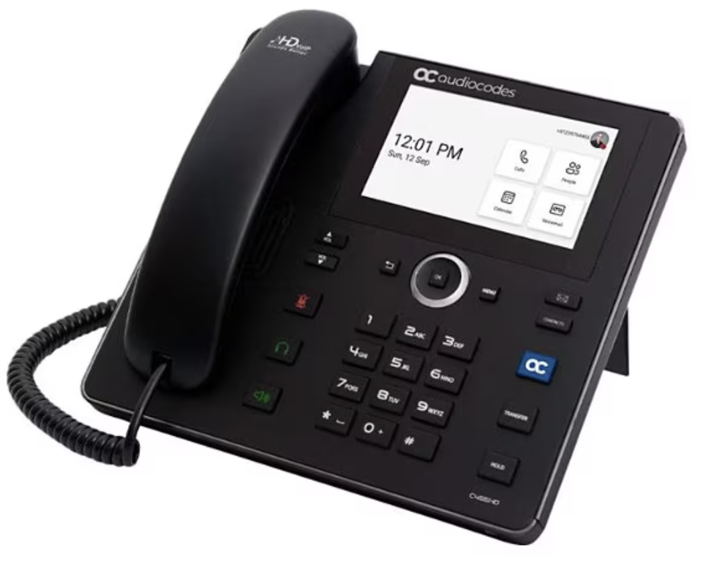
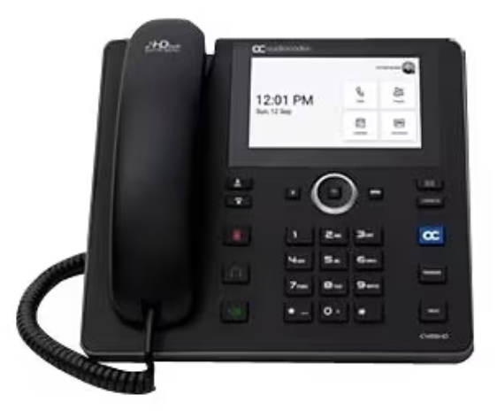
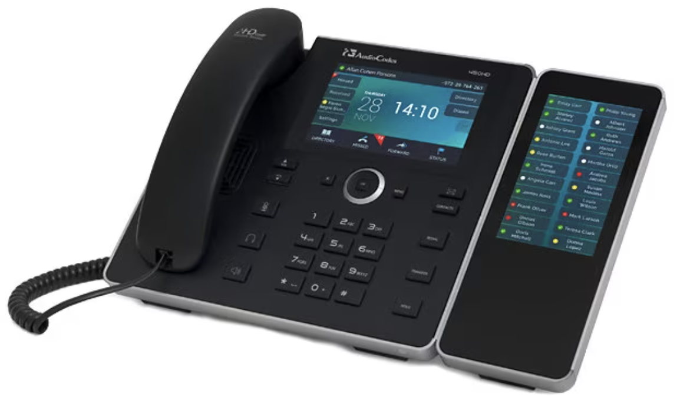
Desk Handsets
 | AudioCodes C455HD | AudioCodes C455HD-DBW | C450 Expansion Module (Sidecar)
Best Suited For | Office Employees | Office Employees, Executives | Office Employees, Executives, Administrative Support Staff
Features
Hands Free | ✅ | ✅ | ✅
USB Headset Support | ✅ | ✅ | ✅
HD Voice Quality | ✅ | ✅ | ✅
Touch Screen | ✅ | ✅ | ✅
Bluetooth/Sidecar Support | ❌ | ✅ | ✅
MSFT Teams Certified | ✅ | ✅ | ✅
Power Over Ethernet | ✅ | ✅ | ✅
Better Together (Bluetooth based) | ❌ | ✅ | ✅
Advanced Features -Call Park, Delegate | ✅ | ✅ | ✅
Wall Mountable | ✅ | ✅ | ✅

Slide 3
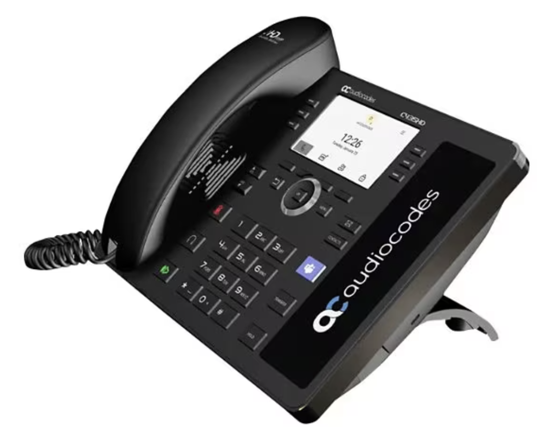
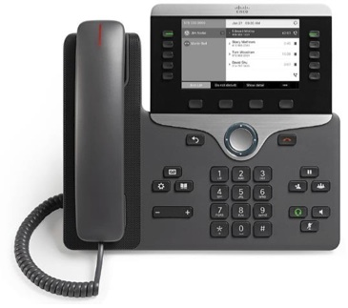
Hallways, Classrooms, Suites, Common Areas Handsets
 | AudioCodes C435HD | Cisco 7821* | Cisco 8811* | Cisco 8851*
Hands Free | ✅ | ✅ | ✅ | ✅
USB Headset Support | ✅ | ❌ | ❌ | ❌
HD Voice Quality | ✅ | ❌ | ❌ | ❌
Touch Screen | ❌ | ❌ | ❌ | ❌
Bluetooth/Sidecar Support | ❌ | ❌ | ❌ | ❌
MSFT Teams Certified | ✅ | ❌ | ❌ | ❌
Power Over Ethernet | ✅ | ✅ | ✅ | ✅
Better Together (Bluetooth based) | ❌ | ❌ | ❌ | ❌
Advanced Features -Call Park, Delegate | ❌ | ❌ | ❌ | ❌
Wall Mountable | ✅ | ✅ | ✅ | ✅
* Cisco devices must have a firmware upgrade purchased to be Teams Compatible

Slide 4
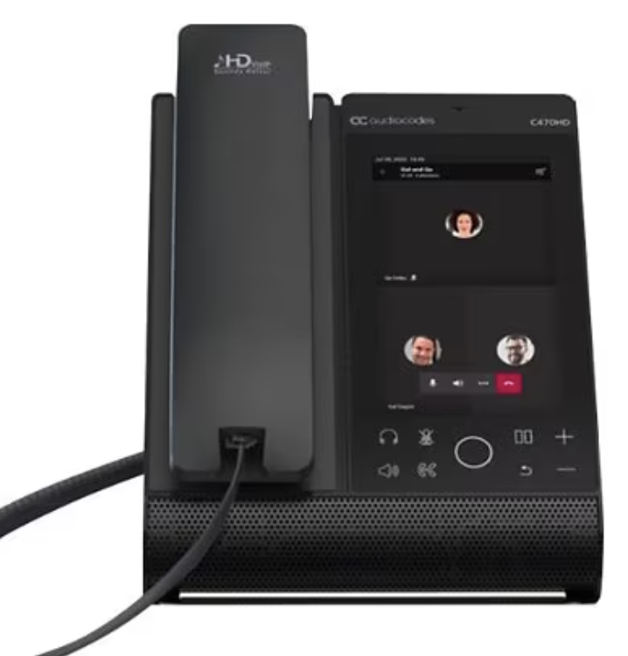
Conference Room Handsets
 | AudioCodes C470HD | Cisco 7832* | Cisco 8832*
Hands Free | ✅ | ✅ | ✅
USB Headset Support | ✅ | ❌ | ❌
HD Voice Quality | ✅ | ❌ | ❌
Touch Screen | ✅ | ❌ | ❌
Bluetooth/Sidecar Support | ✅ | ❌ | ❌
MSFT Teams Certified | ✅ | ❌ | ❌
Power Over Ethernet | ✅ | ✅ | ✅ (with required adapter)
Better Together (Bluetooth based) | ✅ | ❌ | ❌
Advanced Features -Call Park, Delegate | ✅ | ❌ | ❌
Wall Mountable | ❌ | ❌ | ❌
* Cisco devices must have a firmware upgrade purchased to be Teams Compatible

